Slide 1


Embedded SW Oven Challenge
Joel Bursztyn
May
. 2014

Slide 2
Exercise - Oven Solution KingsToaster.txt
Oven Controller
Oven has the following data
Temperature (0.. 400)
Heat: ambient, hot, over Heat
Humidity:
low, mid-low, mid high, high, too High
User – immediate stop request
Off/On button
Turbo Fan on
Electric consumption
Low, Medium, High, Too-High
Time from Start, Time to finish
Heat command
Overide anything except Emergency (heat/consumption)
User Program:
Time & required temperature
Controls:
Heater, Fan, heat on Led, Humidity status,
Emergency LED.
Controls in the next slides
Oven Required special Behavior
On Emergency (any red situation ) stop!
On High Humidity or delta temp>100 start fan
On Delta temp> 10 [dis]operate heater
To Do
Design the SOC to maintain such a Appliance
Write the logic for that oven
KISS and Efficient(where needed)
Generate events (Random and explicit) that test this logic.
Input & Output
User Program generate and print events
Print reaction of the logic to the events

Slide 3
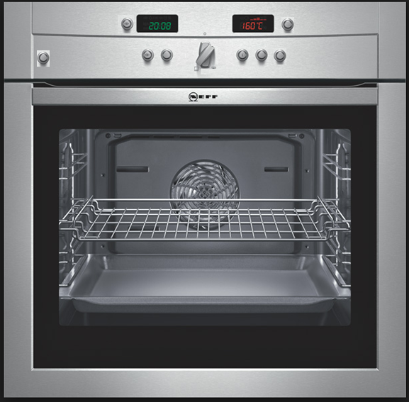
The Oven
Time
Required Temp
On/Off
Stop Immediately
Heat Led On
Heat Immediately
Humidity Status
Emergency-Status
Turbo Fan
Heater

Slide 4
Oven Control
9 8 7 6 5 4 3 2 1 0
Control and Status &1000550
Over Heat
HeaterOn(R/W)
Over Humidity
FanOn(R/W)
Over Current Consumption
HeatLedOn (R/W)
Reset
Humidity LedOn(R/W)
Future Use
Stop Immediately(W)
Future Use
PowerOn
Resolution (bit) | Range | Address | Device
Seconds | 0-3600*36 | 1000554 | Time (R/W)
2 Celsius Degrees | -25- 400 | 1000558 | Heat (R/W)
1 Amper | 0-15 Amper | 4:100055C | Electric Consumption
Low-TooHigh | 0-7 | 3:100055C | Humidity

Slide 5
Oven Challenge
Draw the System Architecture (Hardware)
Draw the SW Architecture Logic view
Identify all the capabilities blocks
Define system State Machine
CPU

